Slide 1
Test Tilt plane of top cover versus optical bench
Detail: Date: 24 April 2025 Description:
Author : Atthaphan Paksakunnee 524161

Slide 2
Objective
Verify surface tilt of optical bench components.
Compare each component's surface against its own reference plane.
Use Keyence IL-065 sensor for high-precision Z measurement.
Process tilt plane using custom Python software.

Slide 3
Concept Overview
Measure 7 points per part: 3 for reference plane, 4 for test surface.
Fit two planes using least-squares method.
Calculate angle between normal vectors of both planes.
Calculate tilt direction in X and Y axes.

Slide 4
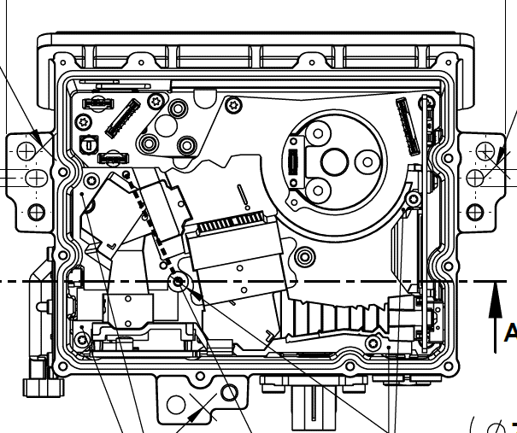
Sensor Layout
Top Cover 3 sensors for Reference Plane.
Optical bench 4 sensors for Test Plane.
Optional: Use 1 sensor with precise linear stage.
All (x, y, z) positions must be known and repeatable.
Reference point
Test point
Y
Y
X
X

Slide 5
Processing Steps
Recalibrate all 7 sensors each day using a flat plate — set all to default (Z = 0).
Login by EN.
Start operation: Insert unit onto the fixture and measure all 7 points.
Top cover (3 points) is defined as the Reference Plane.
Optical bench (4 points) is defined as the Test Plane.
Compute normal vectors for both Reference and Test planes.
Calculate tilt angle difference between planes (in degrees), including pitch (Y), roll (X)
Upload measurement results into the database FITs.

Slide 6

Formula
Plane Equation:
$$\left[\begin{matrix}x_{1} & y_{1} & 1 \\ x_{2} & y_{2} & 1 \\ \begin{aligned}. \\ x_{n}\end{aligned} & \begin{aligned}. \\ y_{n}\end{aligned} & \begin{aligned}. \\ 1\end{aligned}\end{matrix}\right]∙\left[\begin{matrix}a \\ b \\ c\end{matrix}\right]\left[\begin{matrix}Z_{1} \\ Z_{2} \\ \begin{aligned}. \\ Z_{n}\end{aligned}\end{matrix}\right]$$
Normal Vector:
$$\overset{⃑}{n}= \left[−a, −b, 1\right] \left(c\right)$$
$${\overset{⃑}{n}}_{unit}= \frac{\overset{⃑}{n}}{\left\|\overset{⃑}{n}\right\|}$$
Tilt Angle:
$$θ= \left[\cos^{−1}\left(\overset{⃑}{n}ref∙\overset{⃑}{n}test\right)\right]$$
$$θ×\left(\frac{180}{π}\right)$$

Slide 7
Output Result
Z
Station ID
Operator ID
Timestamp
Barcode
tilt angle (degrees).
Roll(X) angle (degrees)
Pitch(Y) angle (degrees)
Direction: forward/backward or left/right.
Result (PASS/FAIL)
Error (TBD)
Pitch
Y
Roll
X

